Slide 1
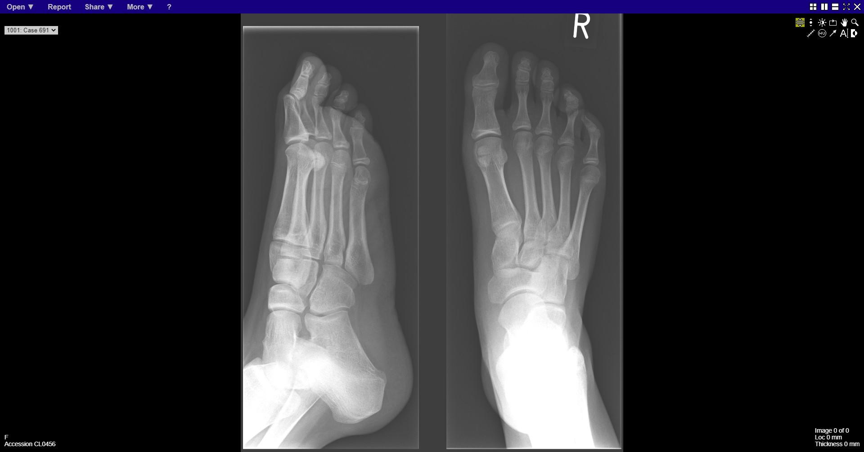
Notes:
normal

Slide 2
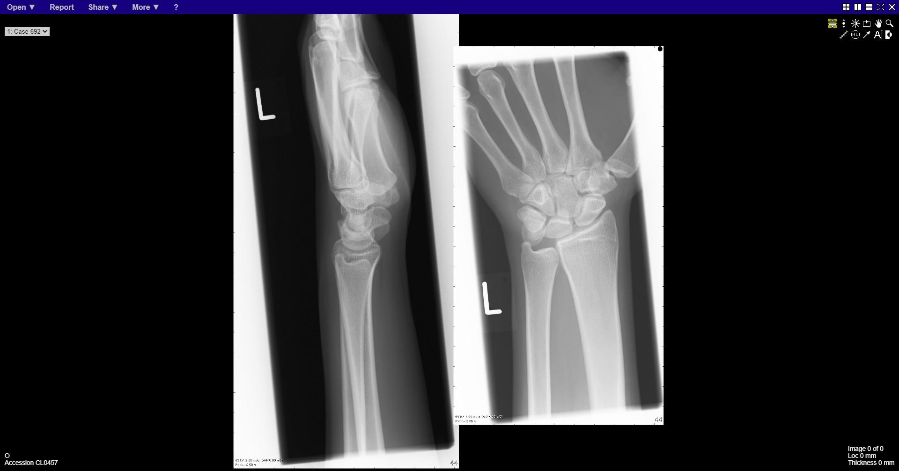
Notes:
normal

Slide 3
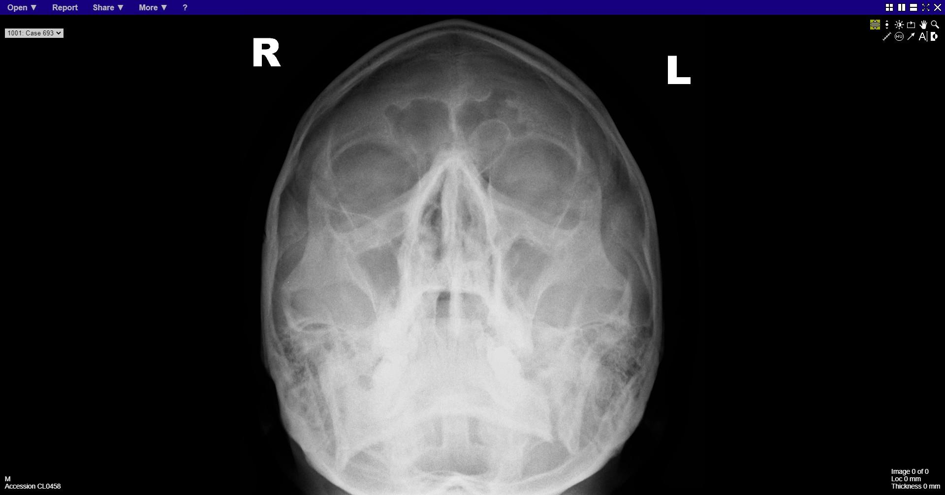
Notes:
Left body of mandible fracture

Slide 4
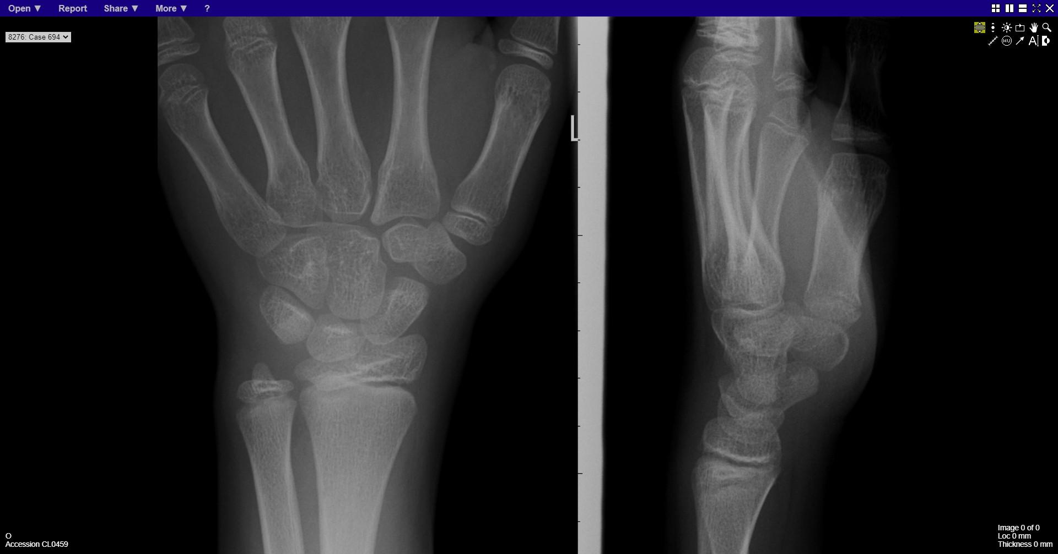
Notes:
normal

Slide 5
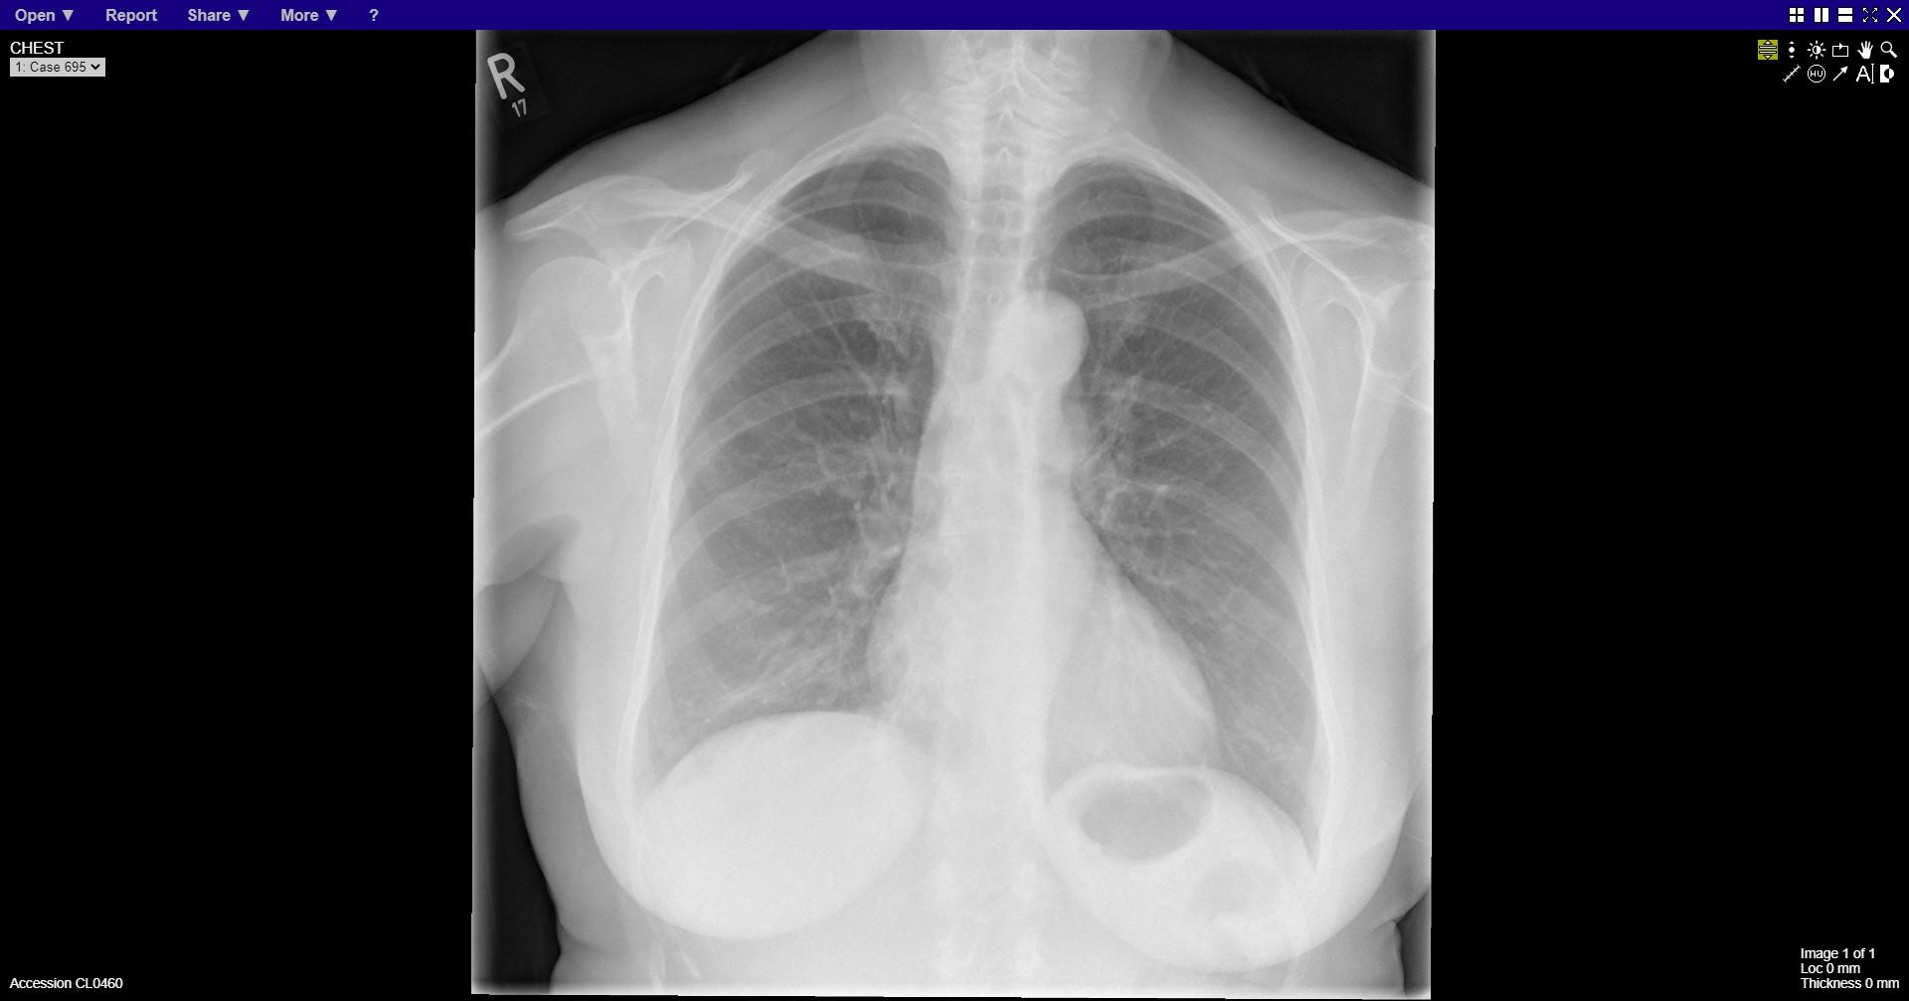
Notes:
normal

Slide 6
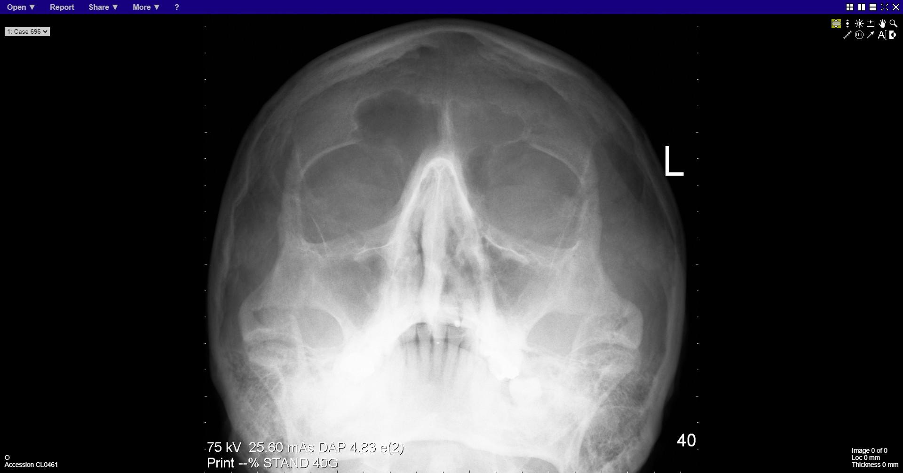
Notes:
Left zygomatic arch fracture

Slide 7
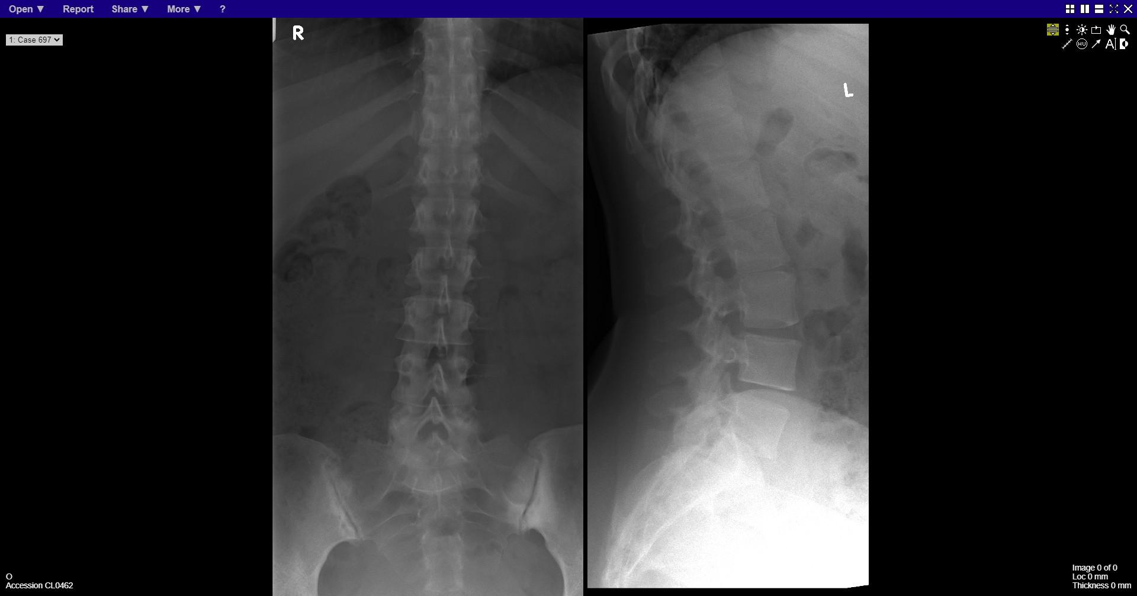
Notes:
sacroiliitis

Slide 8
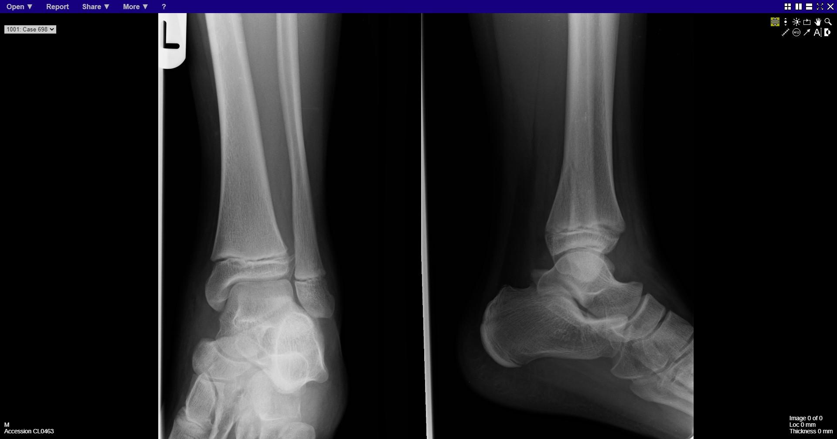
Notes:
Fracture tibia

Slide 9
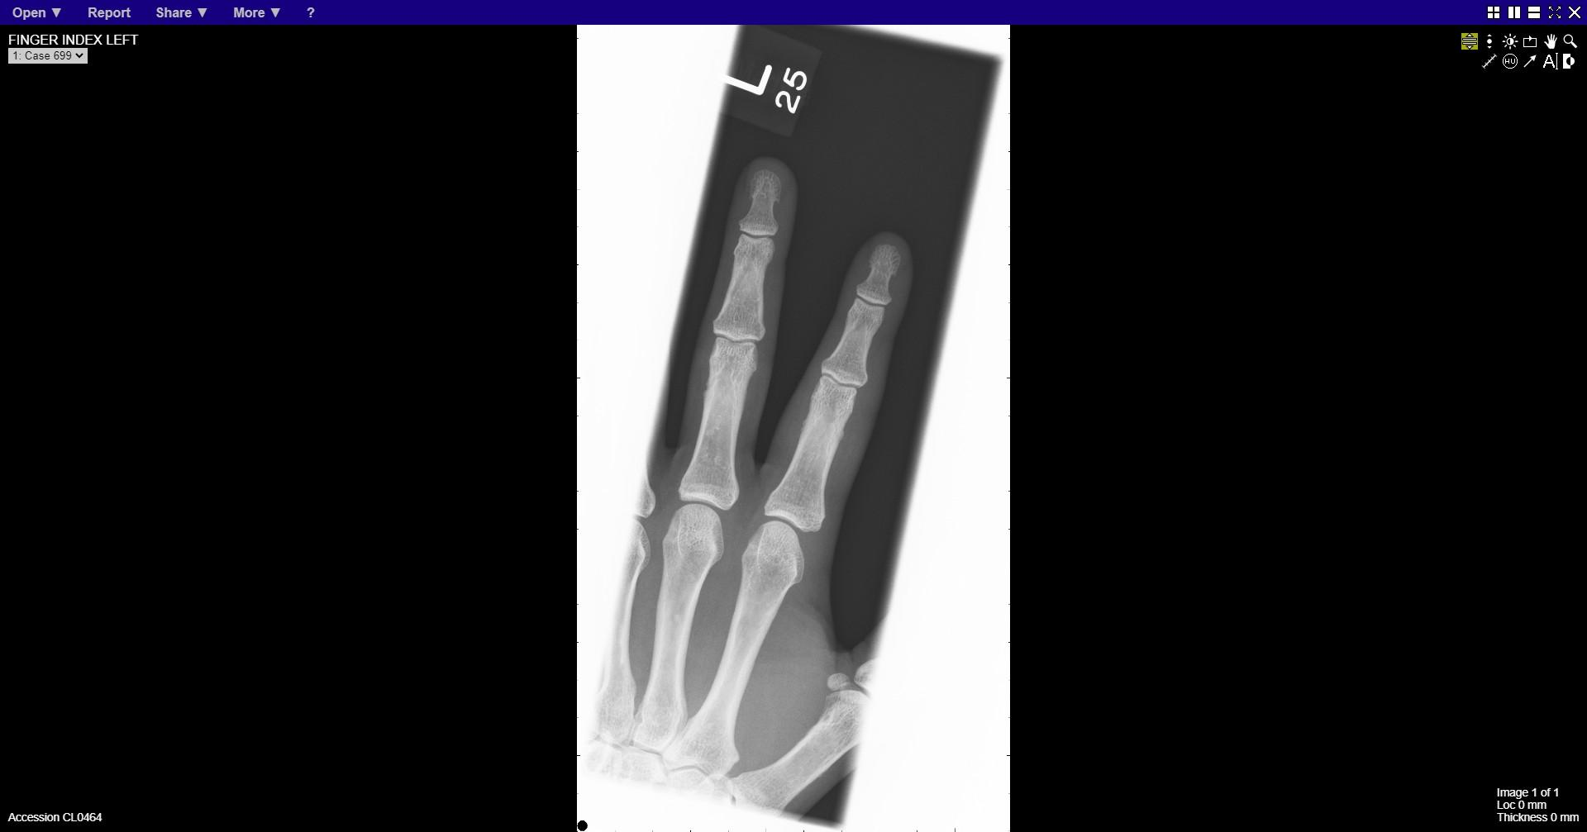
Notes:
normal

Slide 10
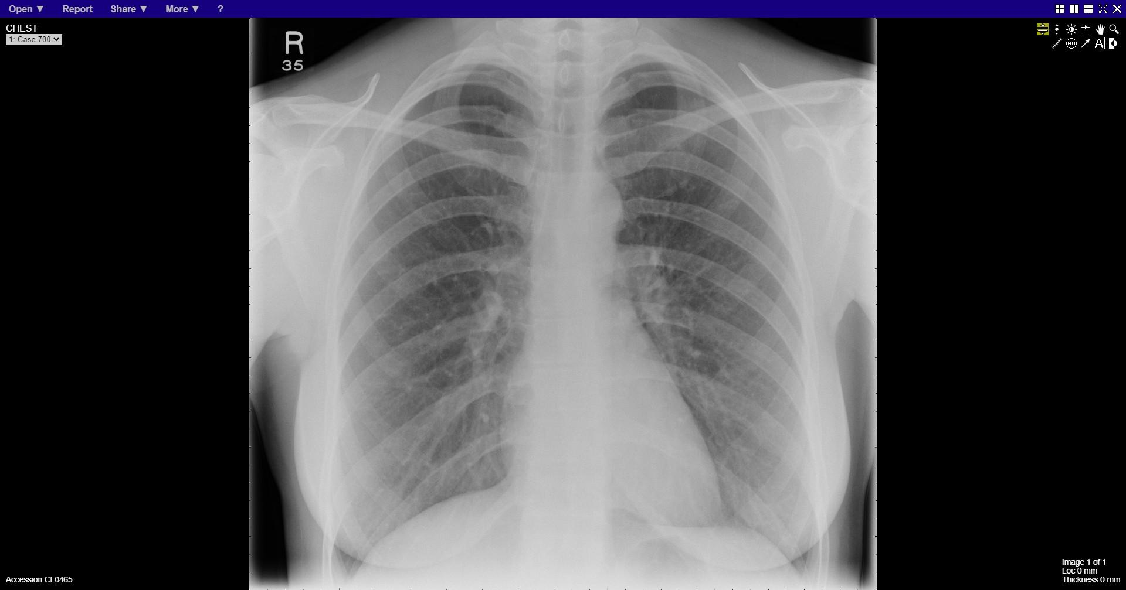
Notes:
Normal

Slide 11
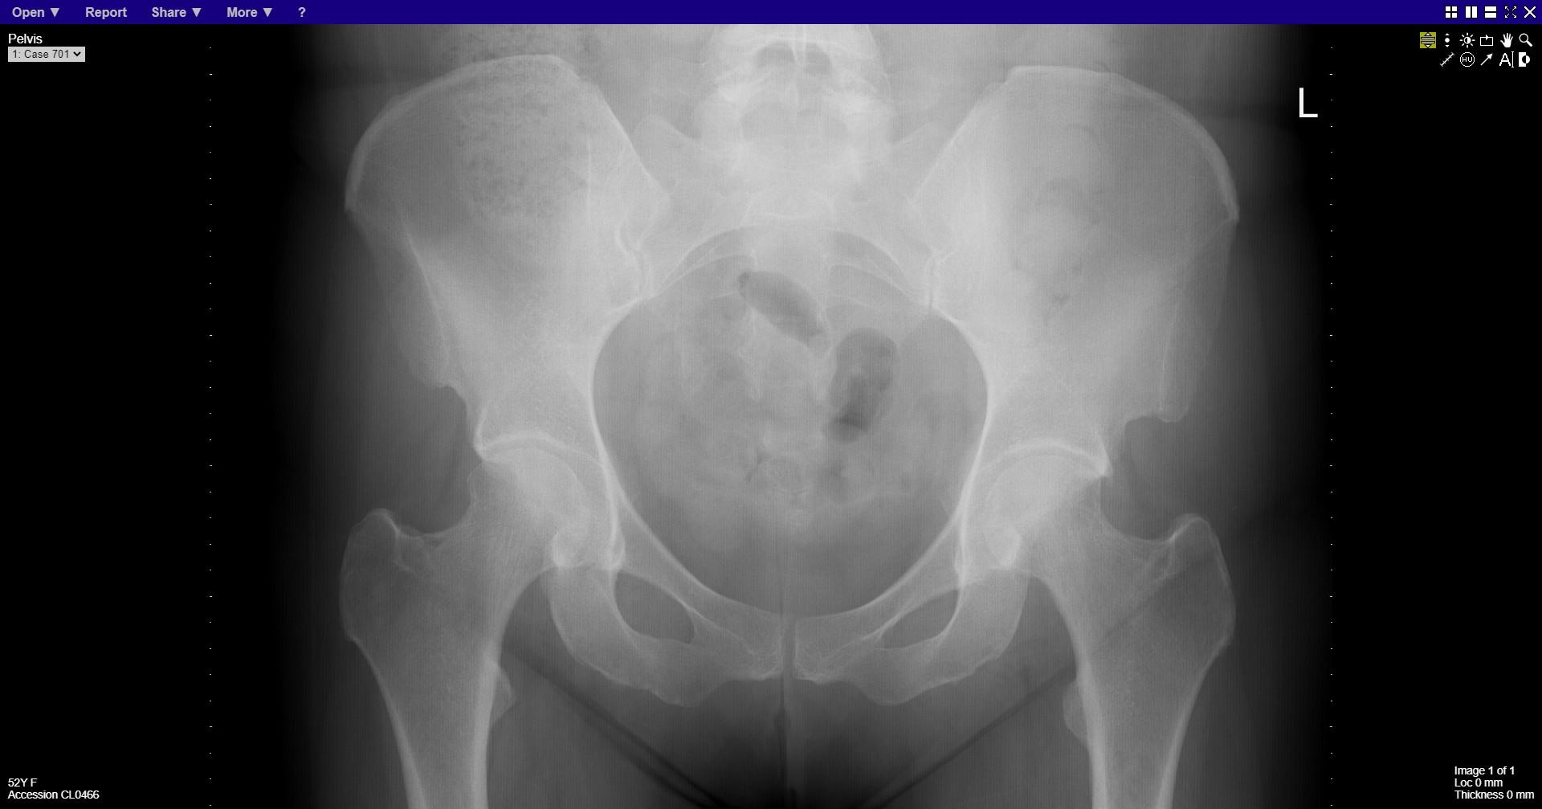
Notes:
normal

Slide 12
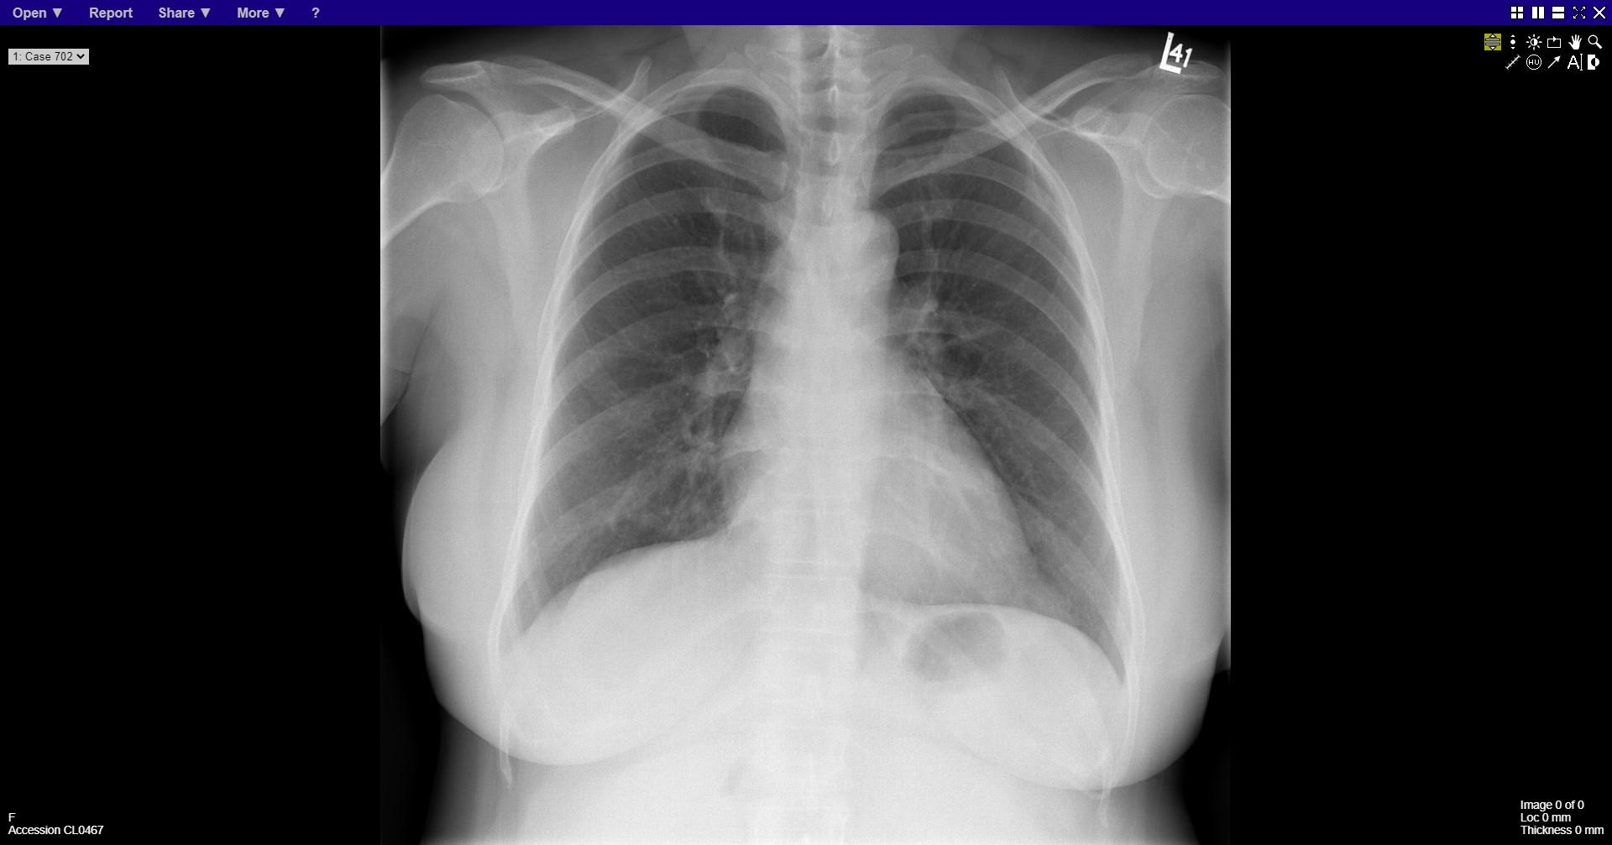
Notes:
normal

Slide 13
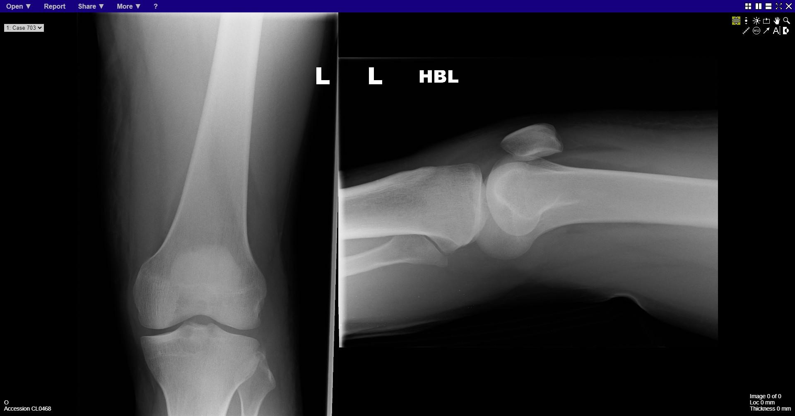
Notes:
Lipohaemarthrosis
Bone fragment adjacent to lateral epicondyle – Segond fracture

Slide 14
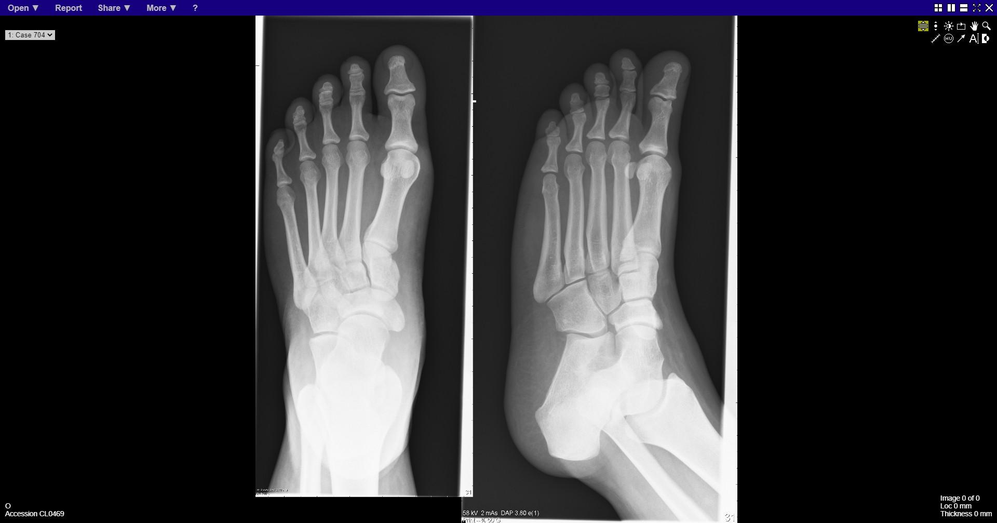
Notes:
normal

Slide 15
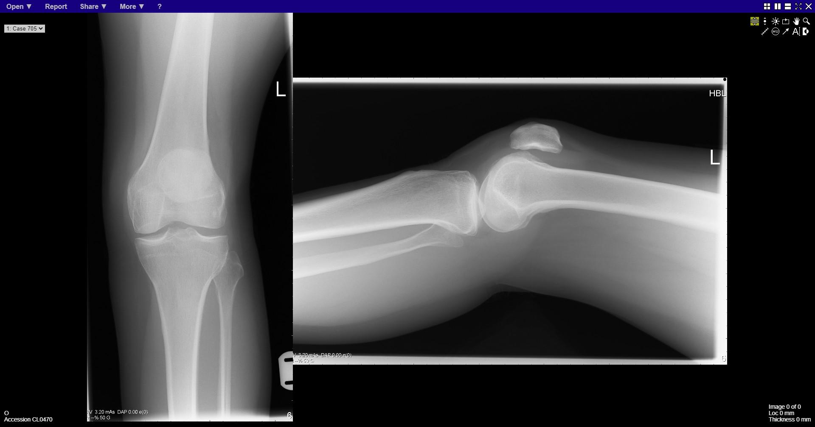
Notes:
Lipohaemarthrosis
No clear fracture

Slide 16
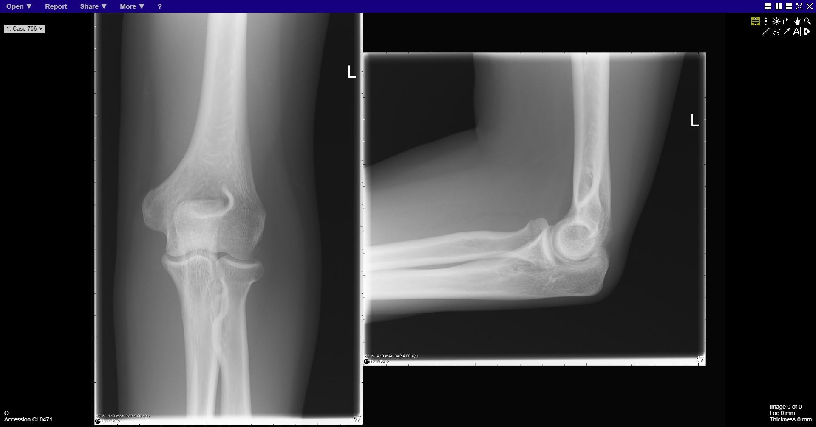
Notes:
normal

Slide 17
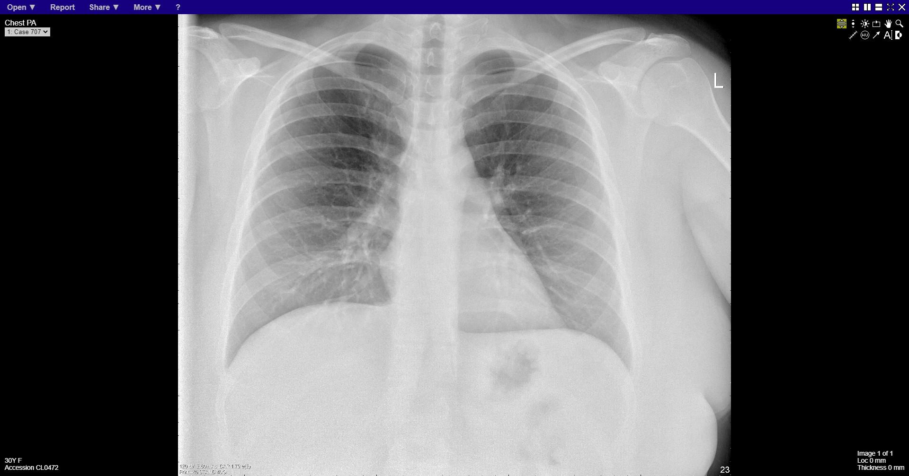
Notes:
normal

Slide 18
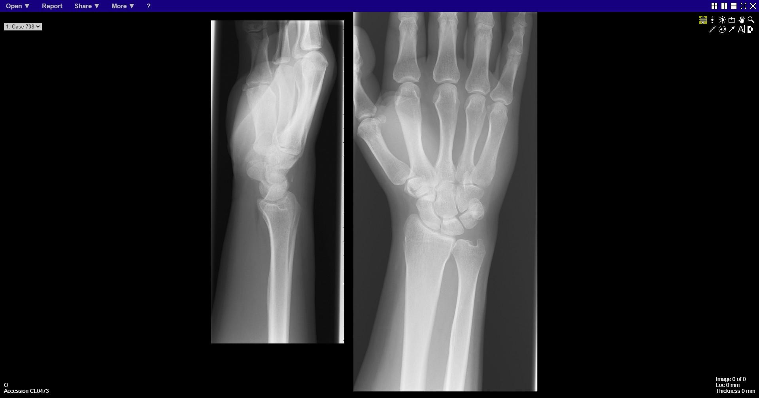
Notes:
Triquetral fracture

Slide 19
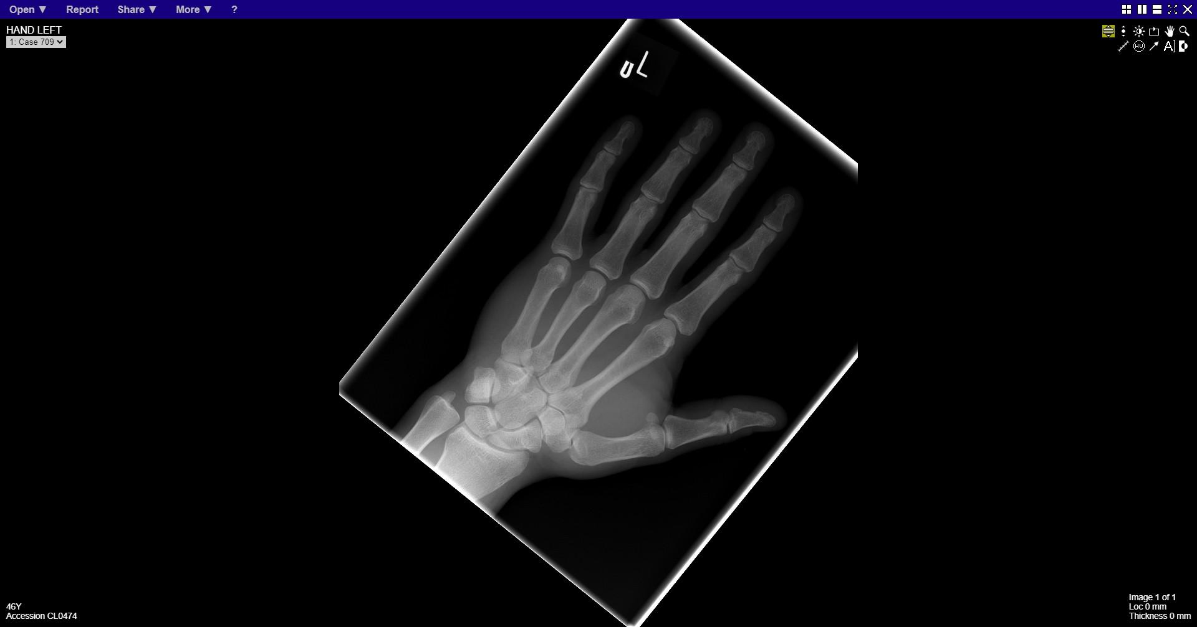
Notes:
normal

Slide 20
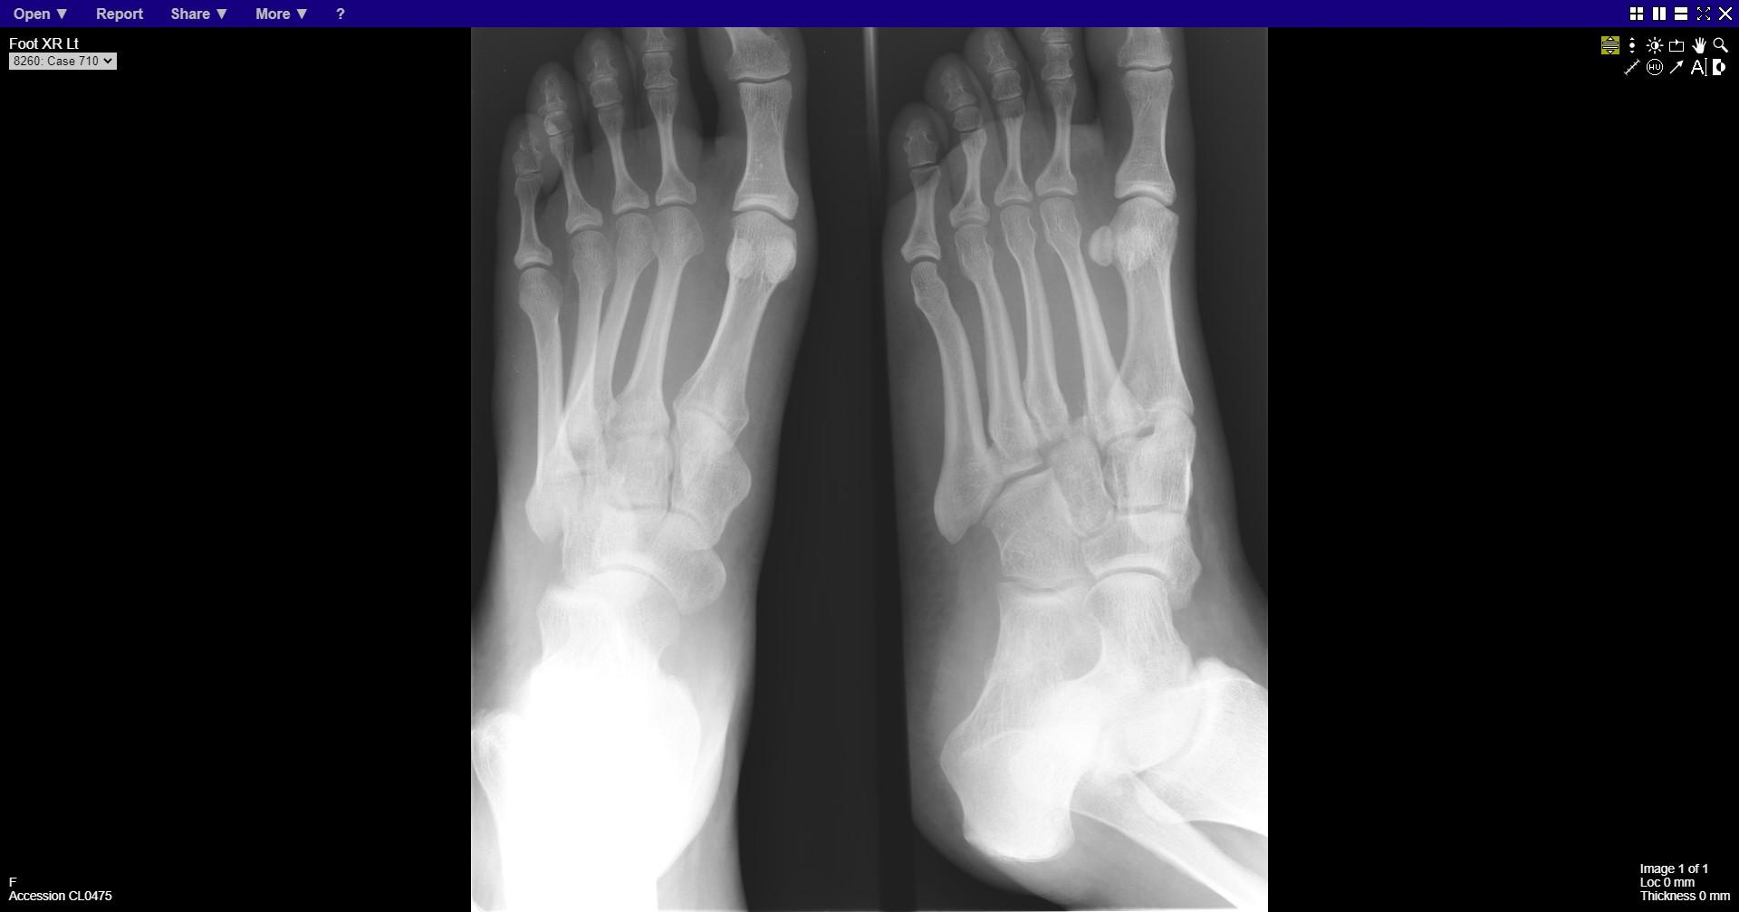
Notes:
Lisfranc
Base of 3rd metatarsal fracture subluxation

Slide 21
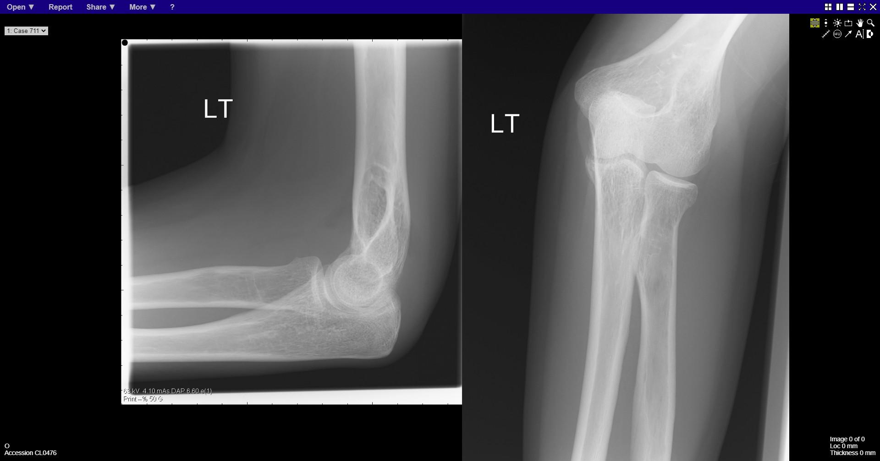
Notes:
Fracture radial head

Slide 22
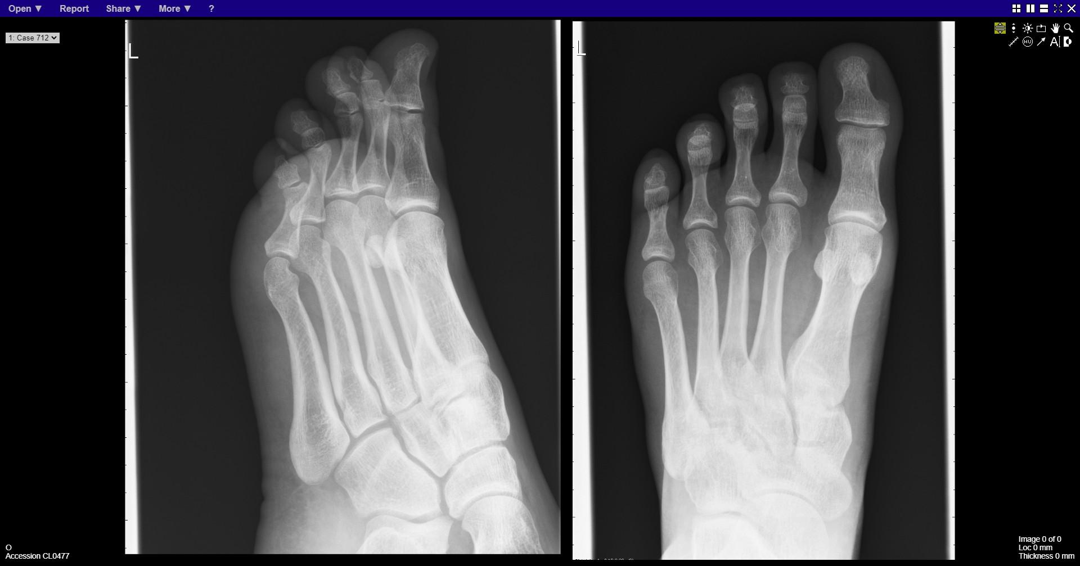
Notes:
Fracture proximal phalanx of 5th toe

Slide 23
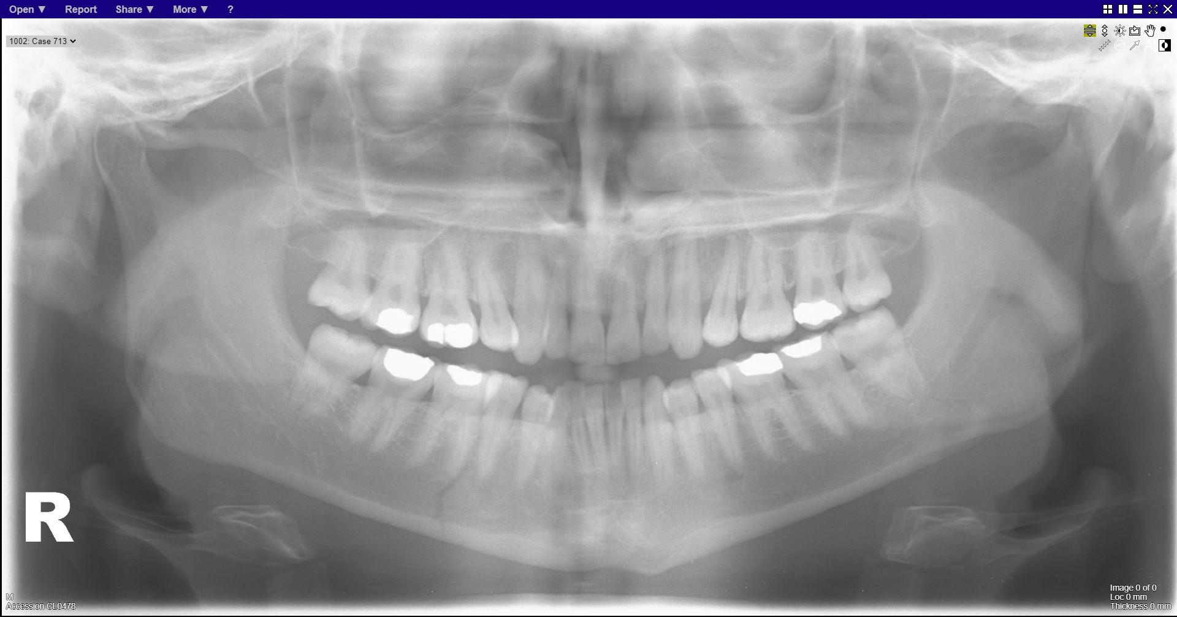
Notes:
Fracture right body of mandible
Subtle fracture left body of mandible

Slide 24
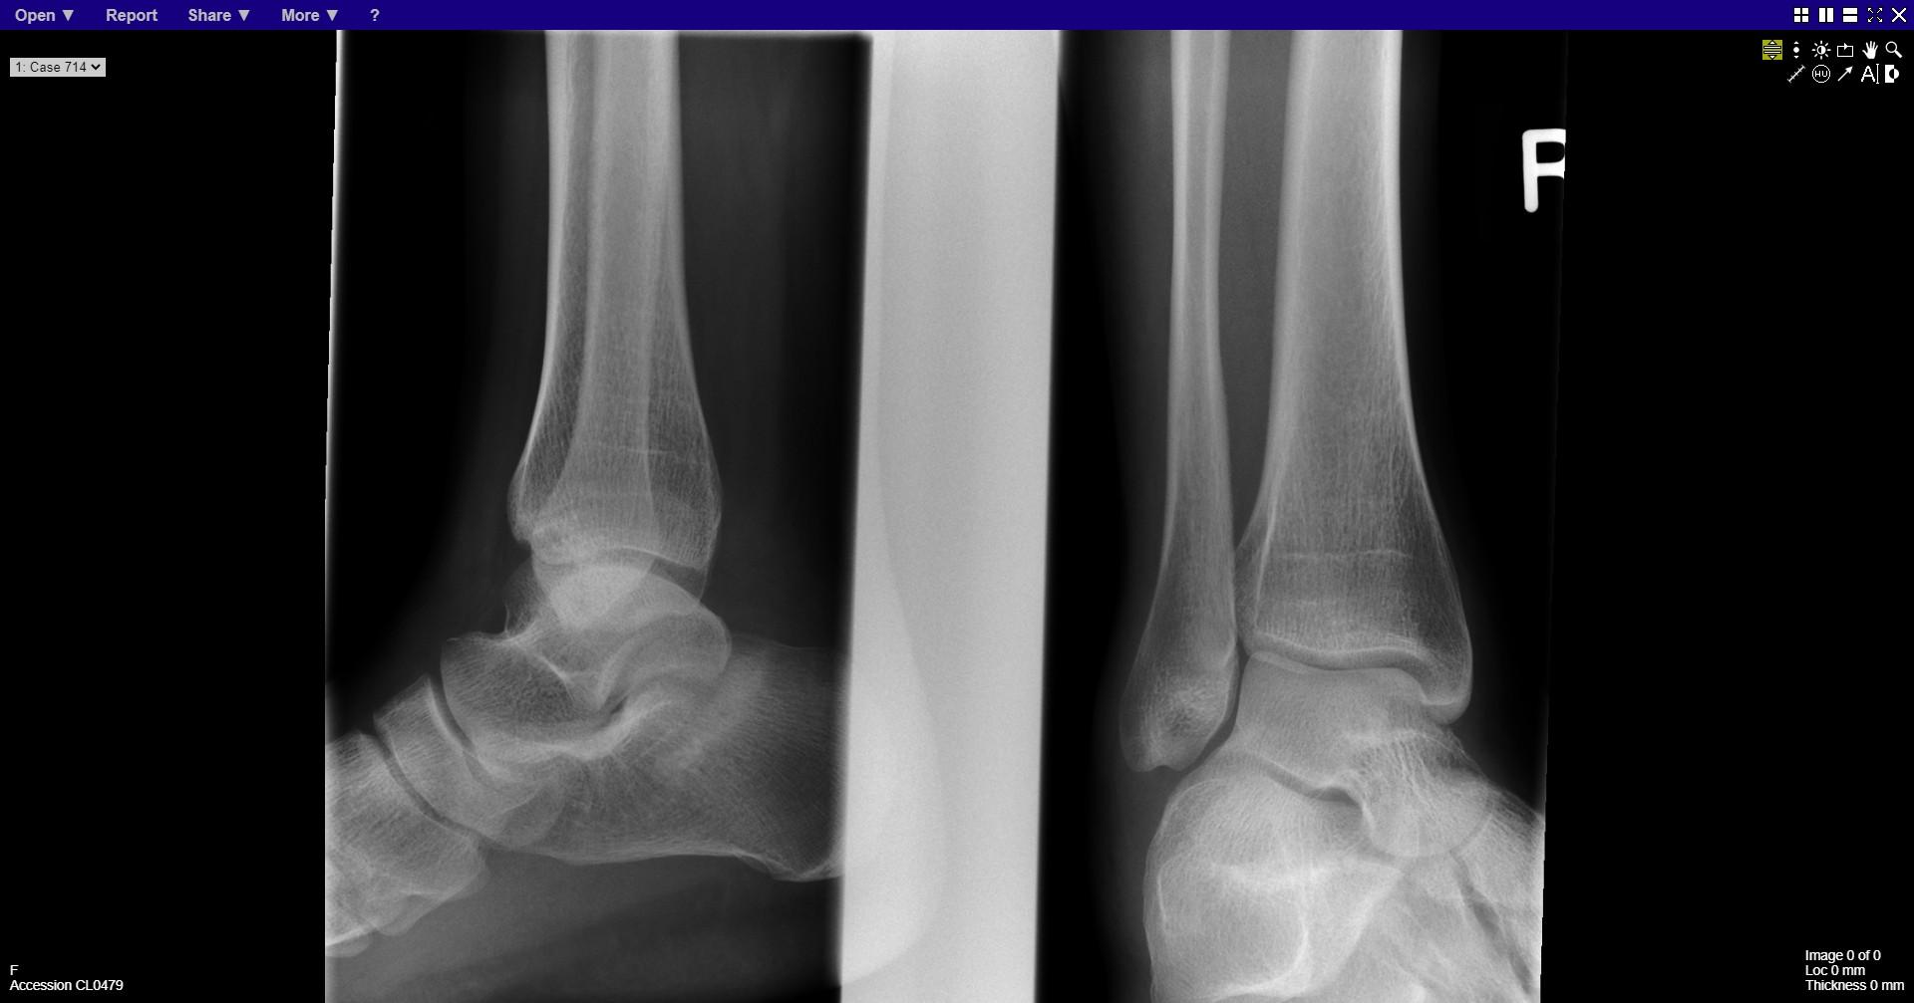
Notes:
Stress fracture calcaneum
Sclerotic area in body of calcaneum

Slide 25
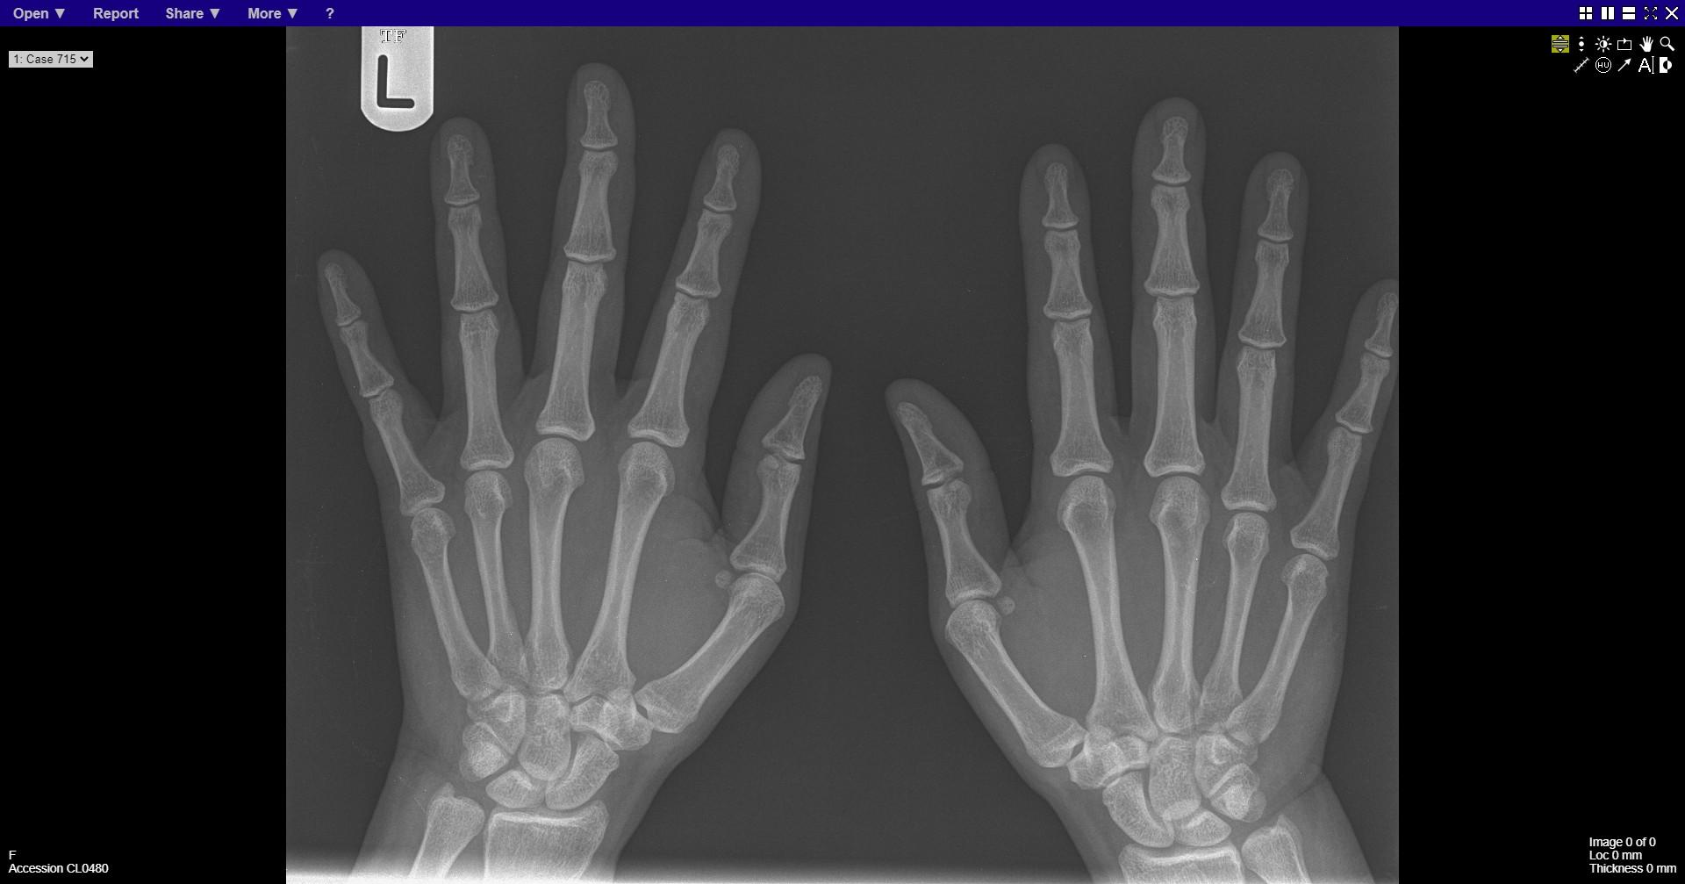
Notes:
normal

Slide 26
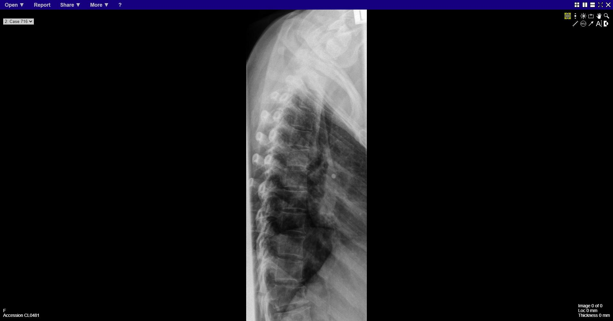
Notes:
Lower thoracic vertebra wedge fracture

Slide 27
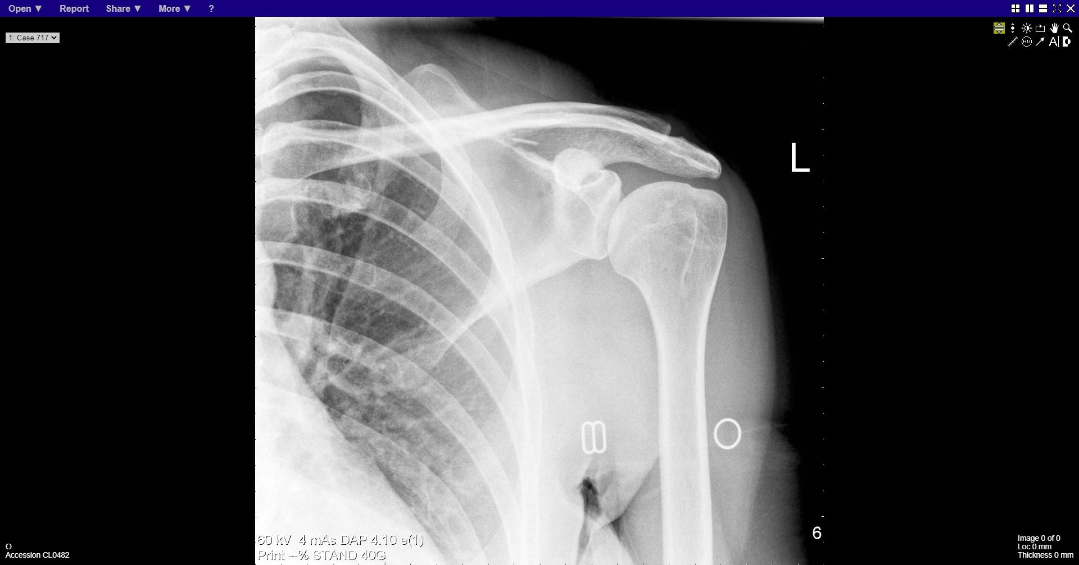
Notes:
Fracture blade of scapula

Slide 28
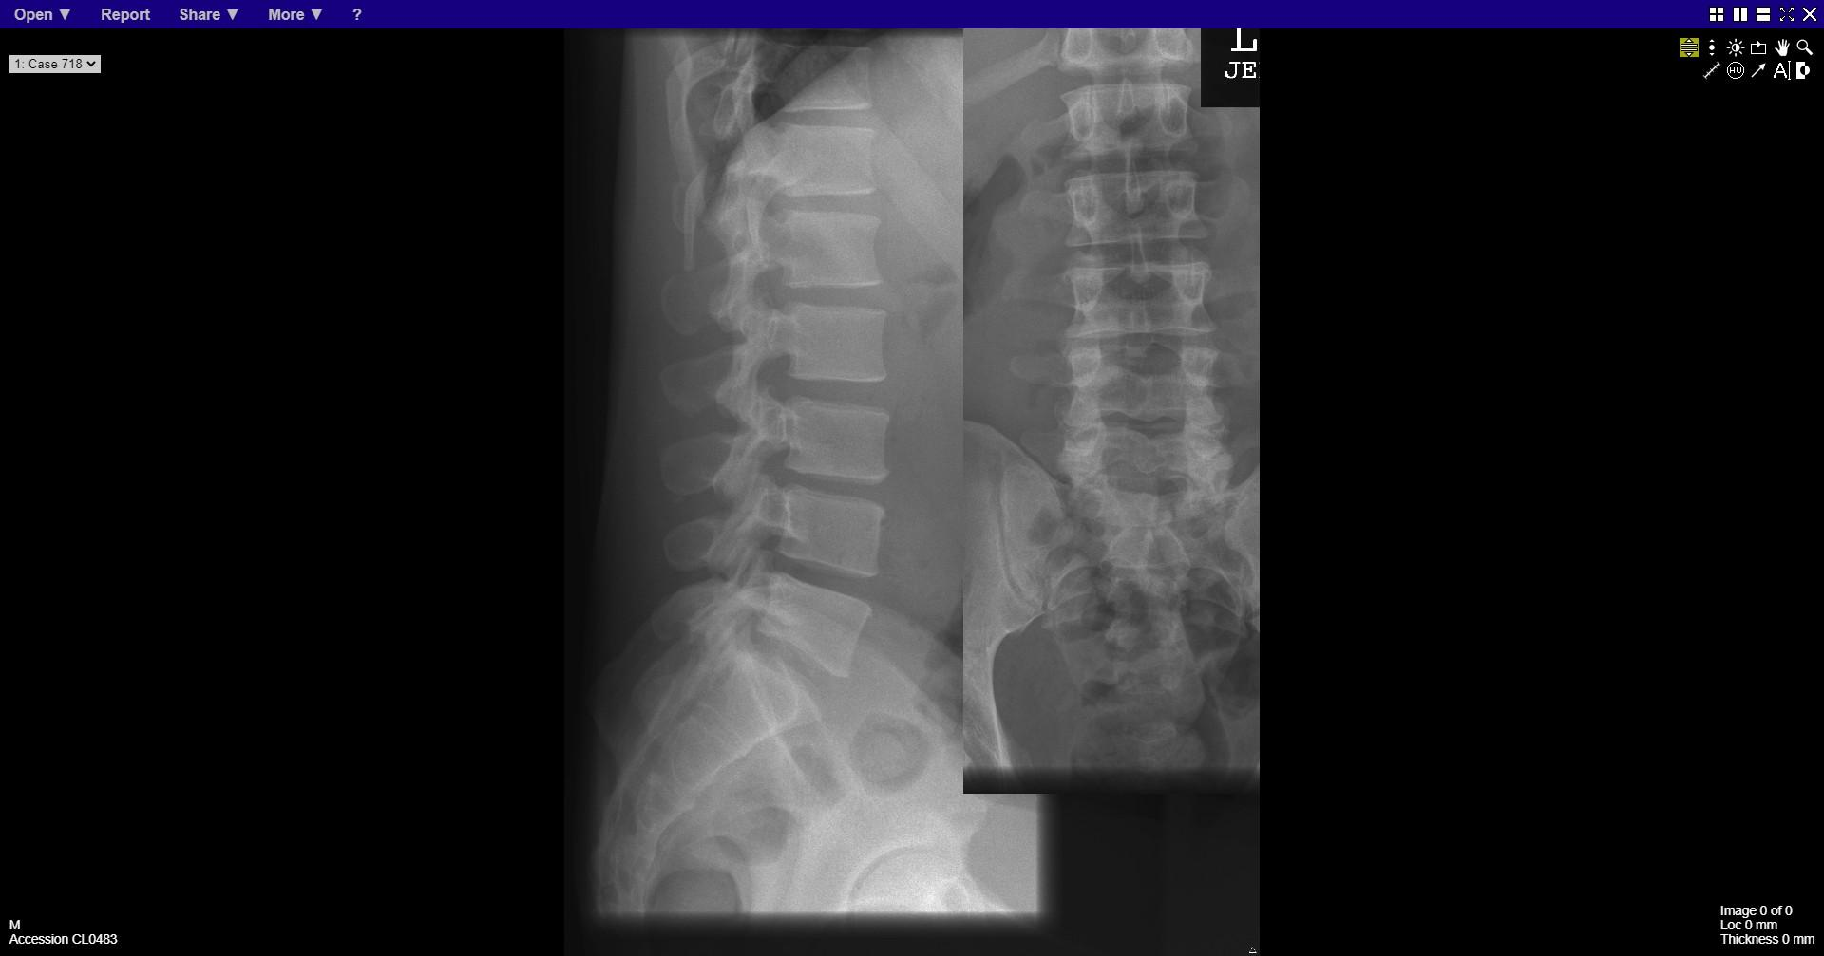
Notes:
normal

Slide 29
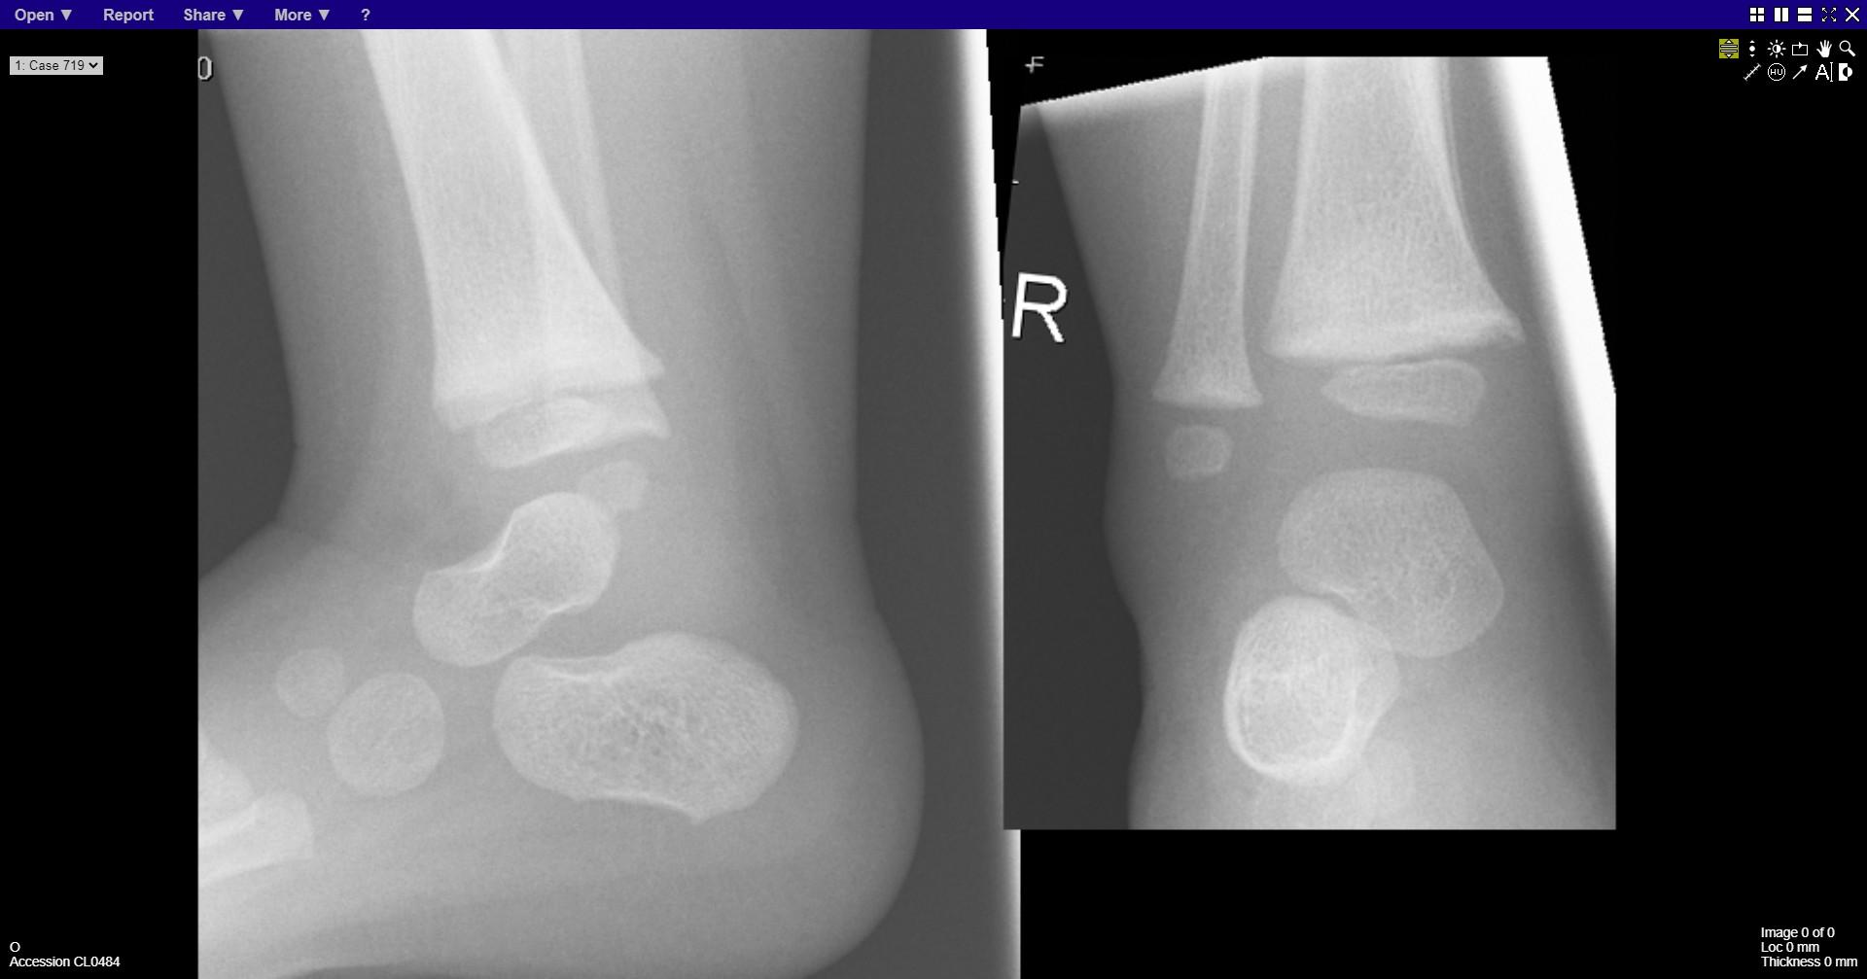
Notes:
Periosteal bone reaction distal tibia

Slide 30
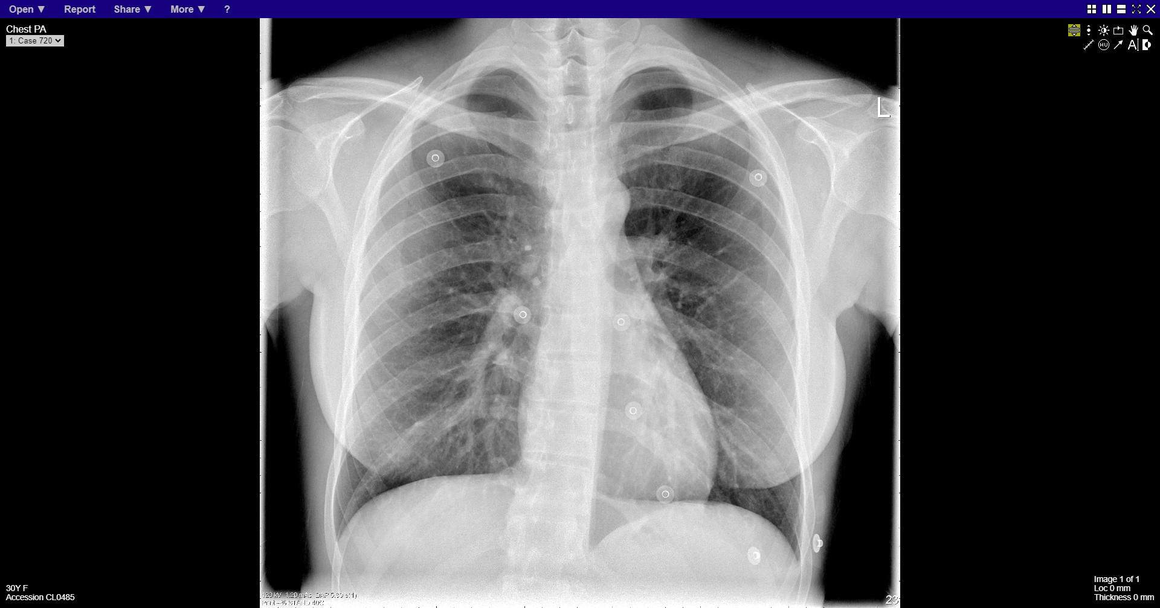
Notes:
normal

